Slide 1


Database Systems
Code : ICS-370
Asif Sohail
University of the Punjab
Punjab University College of Information Technology (PUCIT)

Slide 2
Text & Reference Books
Modern Database Management By Hoffer, Prescott, McFadden.
Database Systems by Thomas M. Connolly.
An Introduction to Database Systems by C.J. Date.
Database Systems by Peter Rob, Carlos Coronel.
Database System, Principles, Design & Implementation by Catherine Ricardo.

Slide 3
Course Information
Lectures & Grades Website: http://online.pucit.edu.pk
Resources Website:
\\printsrv\teacher data\\Asif Sohail
Office: (Ground Floor) Faculty Offices
Students Counseling hours:
email: asif@pucit.edu.pk
Days | Timings
Monday | 3:00 to 4:00 PM
Tuesday | 10:00 to 11:00 AM, 3:00 to 4:00 PM
Wednesday | 10:00 to 11:00 AM, 3:00 to 4:00 PM

Slide 4
Sessional’s Marks Distribution
Category | Marks
Quizzes | 15
Project | 6
Assignments | 4

Slide 5
Data
Data refers to the facts & figures concerning
  PEOPLE
  EVENT
  ORGANISATION
  OBJECT etc.
Known facts that could be recorded/ stored on computer media.
Data is a very important resource for an organization.
Examples: Student’s Record, Employee Photo etc.
The amount of available data in the modern computer world is literally exploding. To get most out of it, we require tools than can simplify the task of managing the data and extract useful information out of it in timely fashion.

Slide 6
Data vs Information
Information is derived from data OR
Information is the Processed data.
Data that has been processed in such a way that it increases the knowledge of the person who uses it
When data is processed and organized into a form needed for its application, it is called an Information Product (IP).
Information is a subset of data which adds to the knowledge.
When needs change, requirements for information change. The same information can have different value when used for different purpose.
We always need information in order to arrive at the appropriate decision.
Information is now increasingly viewed as an organizational asset (Redman, 2008) which can be used to improve organizational performance and help an organization gain a competitive advantage in the marketplace.

Slide 7
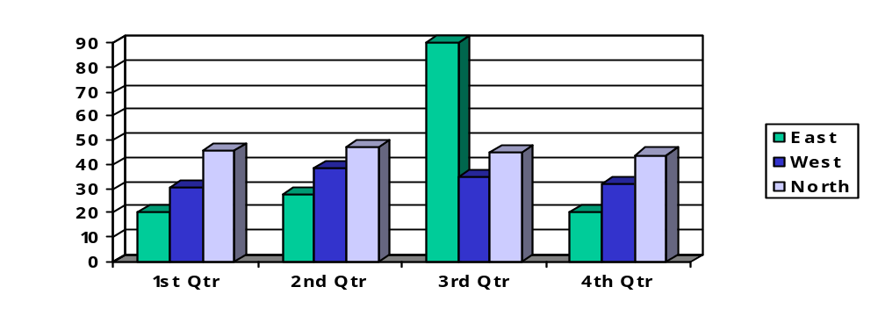
Data vs Information
Information may be presented either Textually or Graphically or both.
The best presentation of information depends on the following factors:
  Do we need precise information or relationship between different values.
  How quickly do the information values change?
  Must the user take some action in response to a change in information?

Slide 8
Data Hierarchy
Field (Data Item)
Record
File
Database

Slide 9
Database
Database is a shared collection of logically related data, and a description of this data, designed to meet the information requirements of multiple users in an organization.
Database System is a System whose overall purpose is to maintain data and make the information available to its users as per their requirements.
The modern day Database System can be regarded as a computerized record keeping system.
The user of the system can perform the operations like:
  Adding / Inserting new Record.
  Deleting & Updating Existing Record.
  Searching.
  Enforcing Security Restrictions etc. etc.

Slide 10
Database
Database is an organized collection of data (and metadata) about the activities of entities and the relationships among these entities.
Metadata: Data that describes properties or characteristics of other data Or Data about data. The description of data is also known as system catalog or data dictionary.
Metadata allow database designers & users to understand What data exists? And What the data mean?

Slide 11
Metadata Example
Data Item |  | Value
Name | Type | Length | Min | Max | Description
Course | Alphanumeric | 30 |  |  | Course ID & Name
Section | Integer | 1 | 1 | 9 | Section Number
Semester | Alphanumeric | 10 | 1 | 8 | Semester & Year
Name | Alphanumeric | 30 |  |  | Student name
ID | Integer | 9 |  |  | Student ID
Major | Alphanumeric | 4 |  |  | Student Major
GPA | Decimal | 3 | 0.0 | 4.0 | Student GPA

Slide 12
Database Applications - Examples
  Student / Employee’s Information System
  Library System
  Hotel / Airline Reservation System
  Billing System
  Stock / Inventory System
  Payroll System

Slide 13
Record Keeping Techniques
Manual Record Keeping.
Computerized Record Keeping
  File Processing System.
  Database System or Integrated Database Environment. (The paradigm shift)

Slide 14
Case Study
Consider a College System consisting of the following offices:
  Admission Office.
  Academics Office.
  Exam Office.
Each Office is maintaining its own set of files for its day to day operations.
Some of the files used in the system are Student’s File, Faculty File, Course File, Correspondence File etc.

Slide 15
Manual System - Drawbacks
High Data Volume.
Not Reliable & Efficient.
Duplication of Data.
Inconsistency.
A Lot of Data Movement is required.
The System can’t answer complex queries involving multiple departments.

Slide 16
File Processing System
File-based systems were an early attempt to computerize the manual filing system.
In the traditional file processing system, the existing manual system is automated by focusing on the data processing needs of the individual departments instead of treating the organization as whole.
Each application will have its own set of Private Files designed to meet the needs of a particular department.

Slide 17
File Processing System
File – 1
App – 1
(operations + data descriptions)
File – 2
App – 2
(operations + data descriptions)
File – n
App – n
(operations + data descriptions)

Slide 18
Case Study: Pine Valley Furniture Company
Company manufactures high-quality, all-wood furniture & distributes it to retail stores nationwide.
Data Processing Needs of Individual Departments
Does not Evaluate overall needs of the system

Slide 19
Continued…
Program
A
Program
B
Program
C
Program
A
Program
B
Program
A
Program
B
Order Filling
System
Invoicing
System
Payroll
System
Customer
Master File
Inventory
Master File
Back
Order File
Inventory
Pricing
File
Customer
Master File
Employee
Master File

Slide 20
Drawbacks of File System
1. Redundancy of Data.
  Redundancy means duplication of data.
  Since applications in FPS are independent so unplanned duplicate data is there.
  Same information is needed to be kept at different places. It costs time and money.
  Same data may have to be input several times to update all the occurrences.

Slide 21
Drawbacks of File System
2. Inconsistent Data.
  Redundancy leads to inconsistency.
  The same data stored at different places may disagree with each other if an operation has not yet been performed against all the occurrences.
  The use of different programming environment and platforms lead to Heterogeneous Environment.
3. Poor Enforcement of Standards
  Organization wide enforcement of standards is poor. This leads to the following types of inconsistencies:
  Synonym: Using Diff. Name for same data. E.g. Stu-Id, Reg-No.
  Homonym: Using same name for different data items. E.g. course for a single subject or entire program.

Slide 22
Drawbacks of File System
4. Excessive Program Maintenance
Physical structure and storage of files are stored in the application code. Against any change in the data, all the application using that data are needed to be changed. Such applications are called Data Dependent Applications.
File descriptions are stored within each application program that accesses a given file (a collection of related records).
E.g. Program A contains a detailed description of Inventory pricing and customer master file.
Any change to a file structure requires changes to the file description for all programs that access the file.
Often difficult to locate all programs affected by change
Errors are often introduced when making changes.
Incompatible file structures.

Slide 23
Drawbacks of File System
5. Limited Data Sharing:
As each application has its own private files so little opportunity to share data with others.
The filing system works well when we have to interact with each file separately. However, it breaks down when we have to cross-reference or process the information in the files. This makes it hard to answer queries involving multiple files.
6. Inflexible.
7. Lack of provision for security.
8. Limited recovery from failure.
9. Non-Concurrent Access.

Slide 24
Integrated Database Environment(IDE)
The limitations of file-based approach can be attributed to the following factors:
  Redundancy of data.
  Data dependence: the definition of data is embedded in the application programs, rather than being stored separately and independently.
In contrast to file processing system, the IDE has a single large repository of data.
Emphasizes the integration & sharing of data throughout the organization.
The organization wide requirements are analyzed as a whole and there is no longer concept of MY FILE or Private Files.
A Database Management System (DBMS) is a software designed to assist in maintaining and utilizing large collections of data.
By storing data in a DBMS rather than as a collection of files, we achieve enormous advantages.

Slide 25
Database System
Database
(Data + Data Descriptions)
D
B
M
S
App – 1 (Operations)
App – 2 (Operations)
App – n (Operations)

Slide 26
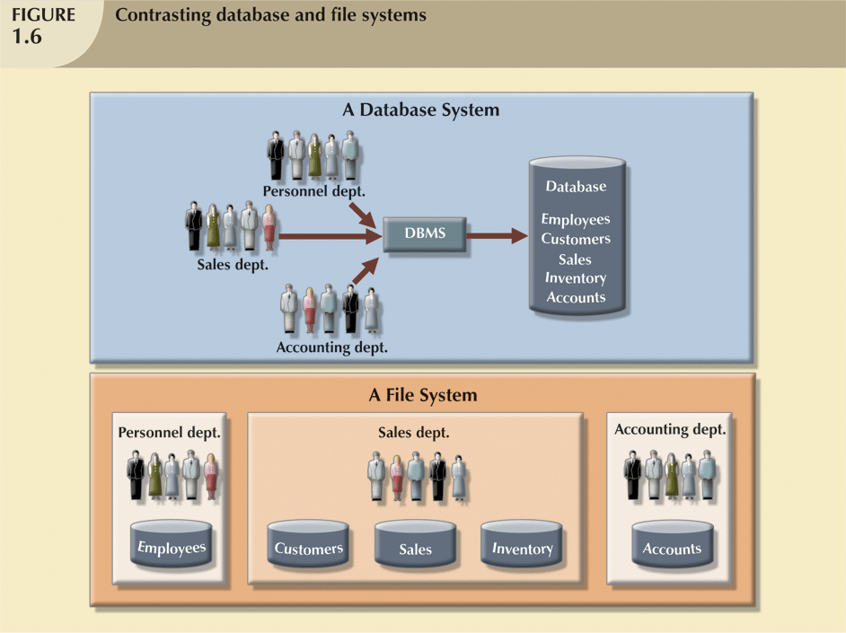


Slide 27
Case Study: Pine Valley Furniture Company
Tough competition lead Pine Valley to adopt database approach.
It involves the following steps:
Step 1:
Develop a list of high level entities that support business activities.
An Entity is an object that is important to business
Entities at Pine Valley Furniture Co. include Customer, Product, Employee, Customer Order, Department.
Step 2:
Develop an Enterprise Data Model: A graphical model that shows the entities for the organization and relationships among them.

Slide 28
Enterprise Data Model
Associations/Relationships
Entities
Customer
Product
Places
Has
Is placed by
Is for
Order
Contains
Order Line
Is Contained by

Slide 29
Advantages of Database Approach
1. Redundancy is Reduced.
  Since all the data items are stored in a single database, therefore Redundancy is minimized.
  Separate data files are integrated into a single, logical structure to reduce redundancy
  100% elimination of redundancy is not possible in order keep the logical connections among the data items.
2. Inconsistency can be avoided.
  Reduction in redundancy automatically avoids inconsistency.
  If a data item appears only once, any change to its value needs to be performed only for once and the database will always be in some consistent / correct state.

Slide 30
Advantages of Database Approach
3. Standards can be enforced.
This is possible as database is designed to meet the organization wide requirements.
The standards can be name of data items and their format, data codes, documentation standards, operation standards, security policies etc.
4. Reduced Program Maintenance & Development
When all the organization’s requirements are satisfied by one database instead of many separate files, the maintenance & development cost automatically reduces.

Slide 31
Advantages of Database Approach
5. Data Sharing
Sharing means that the same data source is used by multiple applications.
Data is centralized and hence can be shared not only by the existing applications but also new applications can be developed to operated against the same data.
6. Integrity can be maintained.
Data integrity refers to the correctness of data.
Integrity constraints or rules ensure that the data stored in the database is purified and accurate.
Integration also means dividing a large group/cluster of data into smaller and more manageable groups.

Slide 32
Advantages of Database Approach
7. Security Restrictions can be applied.
Database security is the protection of database from unauthorized disclosure, Alteration or Destruction.
DBMS provides strong security measures against such threats. Some of them are:
  Password Checks.
  User Defined Procedures.
  Defining user privileges.
  Audit Trial System.
  Data Encryption

Slide 33
Advantages of Database Approach
8. Improved Accessibility & Responsiveness.
In File Processing System, data accessibility is quite difficult as it is procedural based. You should know the detailed procedural steps. HOW TO DO?
On the other hand, accessing data is lot easier in DBMS with the help of a non procedural language – SQL. You only need to know the simple commands or in other words WHAT TO DO?

Slide 34
Advantages of Database Approach
9. Data Independence.
The separation of data descriptions from the applications using the data is called data independence.
Data Independence can also be defined as: “The immunity of an application to change in storage structure – which implies that the applications don’t depend on any particular storage structure”.
Allows change & evolution of database systems without changing the application programs
Without data independence, it is must to understand the arrangements of data elements in order to perform an operation against them.
Different data arrangements will need different algorithms even for the same operation.

Slide 35
Advantages of Database Approach
9. Data Independence.
Clearly, data dependence is not desired because of the following reasons:
Each user should be able to access data in a customized way.
Users should not have to deal directly with the physical database storage details.
Different application may need different physical structure for the efficiency of their operations.
The DBA should have freedom to change the storage structure or access technique or both in response to changing requirements without much disturbing the existing applications.

Slide 36
Database Architecture
To support data independence, DBMS employs three level architecture. These levels / layers are:
  External Level / Layer.
  Conceptual Level / Layer.
  Internal Level / Layer.
This architecture is also called ANSI-SPARC architecture proposed by Standards Planning and Requirements Committee (SPARC) of ANSI.
The objective of the three-level architecture is to separate each user’s view from the way database is physically represented.

Slide 37
Database Architecture
External View- 1
External View- 2
External View- n
Logical Data Independence
Conceptual Level
Physical Data Independence
Physical Level

Slide 38
Continued…
Program Report Definition
Program display Definition
Program transaction Definition
User View 1
(report)
User View 2
(screen display)
User View 3
(transaction)
Conceptual
Schema
Physical
Schema

Slide 39
Continued…
continue…
Sales Officer
Inventory Controller
External
Level
View 1
Item_Name
Price
View 2
Item_Name
Stock
Conceptual
Item_Number Character (6)
Item_Name Character(30)
Price Numeric(5,2)
Stock Numeric(4)
Conceptual
Level
Physical
Stored_Item Length=50
Item # Type = Byte(6), offset = 0, Index = Ix
Name Type = Byte(30), offset = 6
Price Type = Byte(8), offset = 36
Stock Type = Byte(4), offset = 44
Physical
Level

Slide 40
Database Architecture
1. External Level / Layer.
It is the individual user level.
External Schema is used to generate different external views and external records.
An External Record is a Record as seen by a particular user.
DBMS uses External Schema to create a User Interface, which is both facility and barrier.
An External Record may be a virtual one created by combining different Physical Records, Hiding certain data items and performing operations on them.
The external schema evolves as the user needs are changed over time.

Slide 41
Database Architecture
2. Conceptual Level / Layer.
This level describes what data is stored in the database and the relationships among the data.
It includes the logical structure of the database as seen by the DBA.
It also includes the constraints on data, security and integrity information.
Conceptual Schema is used to generate the conceptual view or conceptual record.
The conceptual view is a view of the data “as it really is” rather than as seen by the users.

Slide 42
Database Architecture
3. Internal Level / Layer.
The physical representation of the database on the computer.
It describes where and how the data is stored on the storage devices.
It includes all the internal/physical details such as pointers, indexes, hashing, file organization etc.
This level deals with low-level access methods and how bytes are transferred to and from storage devices.
Internal Schema is used to describe the Internal Record.
An Internal Record is a single stored record.
Physical Level is managed by OS under the direction of DBMS.

Slide 43
Database Architecture
Schemas and Mappings
The overall description of the database is called the database schema.
We have three schemas i.e. external schema, conceptual schema and internal schema.
The DBMS is responsible for mapping between these three types of schemas.
The External – Conceptual Mapping defines the correspondence between a particular External view and Conceptual view.
The Conceptual – Internal Mapping defines the correspondence between the Conceptual view and Internal view.

Slide 44
Types of Data Independence
The major objective for the three-level architecture is to provide data independence, which means that the upper levels are unaffected by changes to lower level.
There are two types of data independence:
Logical Data Independence
Physical Data Independence.

Slide 45
Types of Data Independence
1. Logical Data Independence
It refers to the immunity of the external levels to the the changes in the conceptual level i.e. conceptual level changes are possible without affecting the existing external levels.
The user for whom the changes are made shouldn’t affect the other users and other application programs.

Slide 46
Types of Data Independence
2. Physical Data Independence
It refers to the immunity of the conceptual level to the changes in the internal level i.e. internal level changes are possible without affecting the existing conceptual level.
The internal level changes such as a different physical sequencing of the records, switching from one access method to another, change of data structure, using new storage device etc. should have no effect on the conceptual level.

Slide 47
Further Advantages of Database Approach
10. Better Concurrency Control
Concurrency means the access of database by multiple users simultaneously.
Concurrency Control means to access the database so that all the data accesses are completed correctly.
11. Better Backup & Recovery Procedures

Slide 48
Cost & Risk of Database Approach
Need for new specialized personnel.
Installation Cost & Complexity.
Conversion from legacy system to modern database system.
Organizational Conflict.
Higher Impact of Failure.
Not suitable for applications with tight real-time constraints.

Slide 49
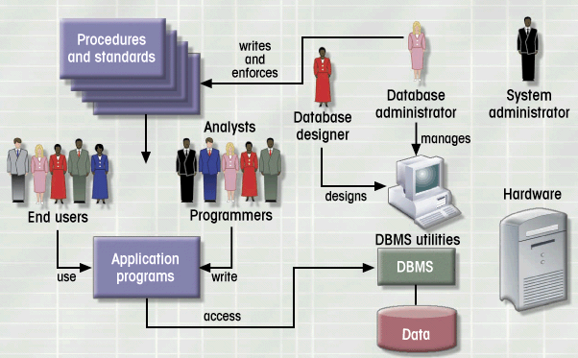
Database Environment

Slide 50
Components of Database Environment
  Application Programs.
  Repository.
  Database.
  DBMS.
  CASE Tools.
  User Groups.

Slide 51
Components of Database Environment
User Groups
Applications
DBMS
Repository
Database

Slide 52
Components of Database Environment
1. Applications
These are the programs used to interact with DBMS and perform all the necessary operations.
These form the Front End for end users
The language used for performing different operations on database is SQL: Structured Query Language pronounced as Sequel.
2. Database
An organized collection of logically related data, usually designed to meet the information needs of multiple users in organization.
It contains all the occurrences of data i.e Actual Data.

Slide 53
Components of Database Environment
3. Repository – Data Dictionary (D/D)
It contains all the data definitions and relationships among them.
The data contained in D/D is called meta data.
D/D includes the information such as field names, data types, size, constraints, aliases, owner, security restrictions, schemas and mapping information etc.
The D/D may be regarded as a database in its own right, but a system database rather than a user database.
D/D is a must for DBMS operations.
D/D is of the same significance for DBMS as is the significance of File Allocation Table for an O.S.

Slide 54
Components of Database Environment
4. DBMS
Commercial software system used to define, create, maintain, and provide controlled access to the Database and also to the repository.
Three basic functions include:
  Defining a database – specifying the metadata (data types, constraints, etc) for data storage
  Constructing a database – storing data
  Manipulating a database – querying the database for specific data, updating the database and generating reports from the data
It manages all the tasks like memory management, user rights, recovery etc.
Examples: MS Access, Oracle, SQL Server, MySQL etc.

Slide 55
Components of Database Environment
4. DBMS - Languages
DDL (Data Definition Language): It allows the user to define database structure, data types and the constraints on the data to be stored in the database.
DML (Data Manipulation Language): It allows the user to insert, update, delete and retrieve data from the database.
DCL (Data Control Language): It allows the user to define different users of the database and their privileges.

Slide 56
Components of Database Environment
5.CASE Tools
It stands for Computer Aided Software Engineering Tools.
These provide the automated or semi-automated support to software process.
Tool Type | Examples
Prototyping Tools | User Interface Generators
Design Tools | Rationale Rose, VISIO
Documentation Tools | Word Processors

Slide 57
Components of Database Environment
6.User Groups
System Developers.
End Users.
i) Naïve Users (Entry Level).
ii) Sophisticated Users (Experienced)
c) Database Administrator (DBA)
DBA is a person responsible for overall management and control of the system. It includes the functions such as:
  Discussing / Liaising with the users and identifying their requirements.
  Developing & Maintaining D/D.
  Defining Security & Integrity Checks.
  Maintaining Backup & Recovery.
  Monitoring performance and responding to the changing requirements & new technology.
  Developing operating procedures.

Slide 58
Functions of DBMS
  Data storage, retrieval and update
  A user-accessible catalog
  Transaction support
  Concurrency control services
  Recovery services
  Authorization services
  Integrity services
  Utility services

Slide 59
Components of DBMS
DBMS is highly complex and sophisticated piece of software that aims to provide the services as discussed.
A DBMS is partitioned into several software components or modules, each of which is assigned a specific operation.
  Database engine
  Data dictionary
  Query processor
  Report writer
  Forms generator
  Communication & integration utilities
  Security utilities

Slide 60
Components of DBMS
Database Engine – responsible for storing, retrieving, and updating the data
Data Dictionary – holds the metadata of the data tables
Query Processor – allows users to store and retrieve data with the use of a query language
Report Writer – generates database reports
Forms Generator – helps to create input forms for tasks such as data entry
Application generator – has tools (menus, toolbar generators, etc) to assist the developer in creating a complete application
Communication and integration utilities – help data storage and usage on different machines, from different locations
Security utilities – establish and maintain security access controls

Slide 61
The Range of Database Applications
Single user with desktop computer
Main frame computer with thousands of users
Categories are:
  Personal computer databases(Single User)
  Workgroup databases(Multi-user )
  Department databases (Multi-user )
  Enterprise database (Multi-user )
  Internet, Intranet & Extranet DBs (Multi-user )

Slide 62
The Range of Database Applications
Personal Computer Databases
Support one user with a standalone PC
E.g. a student’s own database or a sales person’s simple database
Workgroup Databases
Workgroup: relatively small group of people who collaborate on same project/application.
A workgroup DB supports the collaborative efforts of a workgroup.
Allows data sharing.
Its model is shown on the next fig:

Slide 63
Continued…
LAN
DB Server
Workgroup
DB
Workgroup DB on LAN
(Method of Data Sharing)

Slide 64
The Range of Database Applications
Department Databases
Department: Functional unit within an organization
Department DBs support function & activities of a department.
E.g. personnel DB to track employees, jobs, skills etc.
Enterprise Databases
DB scope is the entire organization
To support organization-wide operations & decision making.

Slide 65
Continued…
Hospital
Medical
Clinic
Corporate
Office
Hospital
Nursing
Home
Data Warehouse
Medical
Clinic

Slide 66
The Range of Database Applications
Internet, Intranet & Extranet Databases
Internet: A worldwide network that connects users of multiple platforms easily through an interface known as web browser
Extranet: Use of Internet protocols to establish limited access to company data & information by the company’s customers & suppliers
Intranet: Use of internet protocol to establish access to company data and information that is limited to the organization
Centralized & Distributed Databases
Centralized database system – supports a database located at a single site
Distributed database system – supports a database distributed across several different sites

Slide 67
Other Database Systems
The past few years have produced advances in technology leading to exciting new applications of database systems such as:
  Multimedia databases
  Geographic information systems
  Data warehouses
Multimedia databases – store pictures, video clips, and sound messages
Geographic information systems (GIS) – store and analyze maps, weather data, and satellite images
Data warehouses & on-line analytical processing (OLAP) or on-line transaction processing (OLTP) systems – used to extract and analyze useful information from very large databases for decision-making.

Slide 68
Thank you for your attention.
Asif Sohail
Assistant Professor
University of the Punjab
Punjab University College of Information Technology (PUCIT)
Allama Iqbal (Old) Campus, Anarkali
Lahore, Pakistan
Tel: +92-(0)42-111-923-923 Ext. 154
E-mail: asif@pucit.edu.pk

